Slide 1


Macro Data Clustering
AARSH SACHDEVA

Slide 2
Table of Contents
Overview
Data Collection
Feature Engineering
Composite Indicators
Clustering
Quantopian Strategies
Macro Based Selection
Next Steps

Slide 3
Overview
Since business cycles are natural, repetitive parts of the economy, economic data in one time period should resemble something we’ve encountered in history
Eg: Data collected during recessions will most likely reveal low growth, low inflation, negative sentiment, high unemployment, etc.
An interesting investment strategy would be to compare current economic data to historical data and identify the investment strategies most likely to perform best given macroeconomic conditions
This project utilized approximately 66 different economic indicators to create 6 composite indicators that were then analyzed against historical data for clustering and strategy selection
I was inspired to pursue this project after coming across the idea in “Big Data and AI Strategies”, a paper published by J.P. Morgan in May 2017

Slide 4
Data Collection

Slide 5
Economic Indices
Most of the data was collected on a Bloomberg Terminal. Others were collected from publicly available website (OECD).
66 raw features were used in this project with some data beginning in mid-1920.
Raw economic data however, needs to be manipulated in order to be useful as an indicator. This is why feature engineering was so essential to this project.

Slide 6
Feature Engineering Process
Prior to clustering data or creating composite indicators, it’s important to make sure all the data is scaled.
Furthermore, when dealing with time series data, it’s often important to make the data stationary or at least detrend the data, so it can be useful for future prediction or classification purposes.
Careful thought must be given to each feature and the targeted result in order to create high quality indicators.

Slide 7
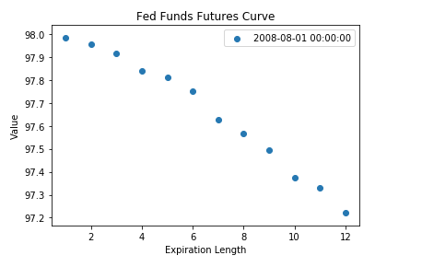
Feature Engineering Process
Understand what economic indicator is desired and what features must be used to produce that indicator
Often times, the indicator is a single feature itself. Other times, it must be calculated using multiple inputs.
Eg: An estimate of the term structure in Fed-Funds Futures requires regression analysis over different expiration dates (I used the coefficient attached to the quadratic term for every date).

Slide 8
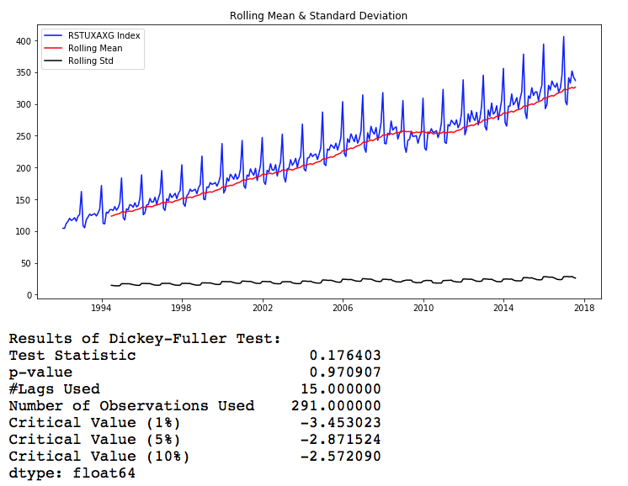
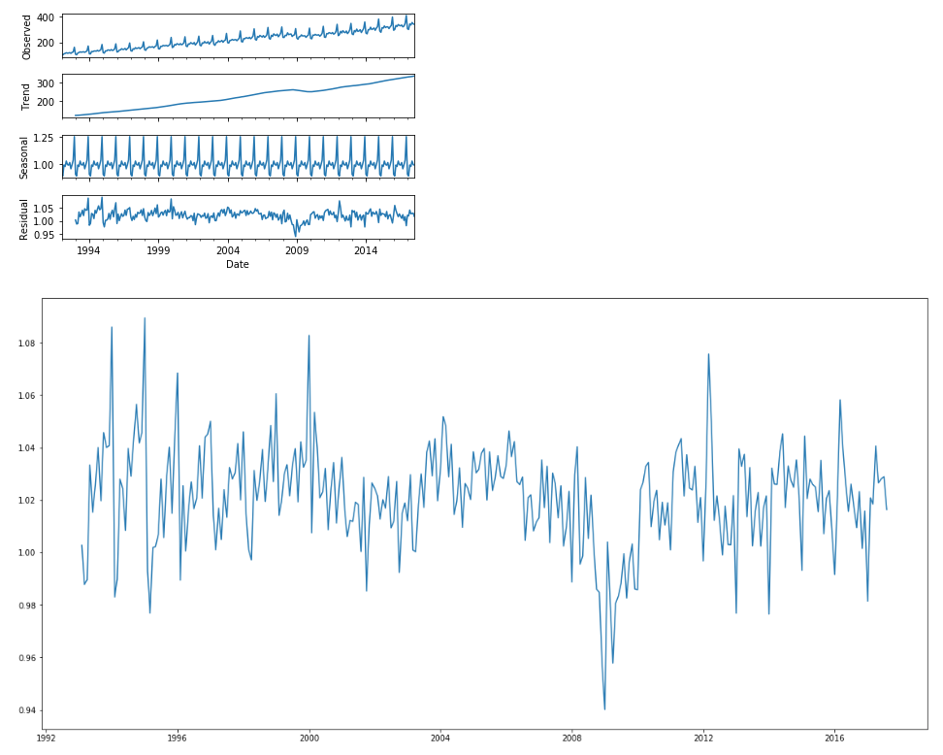
Feature Engineering Process
Analyze the time series of the indicator and determine whether it needs to be made stationary, and if so, what the best method to do so is (differencing vs decomposition).
Note: it’s important to exercise careful judgement in this step, as it doesn’t always make sense to manipulate certain data. Eg: You wouldn’t want to detrend survey data, even if it isn’t stationary
Also important to only use one-sided decomposition to avoid look-ahead bias
Retail Sales ex. Transportation Before and After Decomposition

Slide 9
Feature Engineering Process
Normalize all variables, this is necessary for clustering and composite indicator creation
Since the end goal of this project is to conduct a backtest, I split up my data with a 70/30 split. The training set ranged from approximately early-1997 to 2011 and the test set included everything from then on.
The training was used to calculate the “population” mean and standard deviation, which was then applied to both sets of data for normalization purposes. This way, look-ahead bias was avoided in my test set.
Note: I thought it would be best to remove all rows where at least 25% of my features were missing, which is why the training set began in 1997.

Slide 10
Feature Engineering Process
Group features into 6 categories to create the composite indicators. This required analysis of the economic interpretation of the variable itself.

Slide 11
Sentiment Features
ISM Manufacturing PMI
Michigan Consumer Sentiment
Barclays Credit Default Swaps 5Y and 10Y Spreads
10Y Bond Yield (detrended, multiplicative)
Fed Funds Futures Term Structure (estimated by quadratic regression coefficient on each date)
10Y/2Y Bond Yield Spread
Credit Managers Index
Loan Officers Survey (Average of collected surveys)

Slide 12
Growth Features
Initial Jobless Claims (1st order differencing with a 52 week lag)
US Leading Indicator (decomposed, additive)
Global Leading Indicator (decomposed, additive)
Baltic Dry Index
Manufacturing New Orders ex. Transportation (decomposed, multiplicative)
New Housing Units Started
Dow Jones Transportation Average (12M Change)
Commercial Loan Growth

Slide 13
Growth Features
Railroad Freight Index (12M Change)
Global GDP (12M Change)
Moody’s BAA-AAA Spread
Barclay’s High Yield Spread
M2 Money (12M Change)
House Price Index (12M Change)
ISM Prices Index (12M Change)
Leading Indicators-Lagging Indicators Spread

Slide 14
Coincident Features
Citi US Economic Surprise Index
Citi Global Economic Surprise Index
ISM Non-Manufacturing NMI
Retail Sales ex. Transportation (decomposed, multiplicative)

Slide 15
Quant-Macro Features
Margin Debt Level (12M Change)
US to World (detrended, additive)
VIX
Small-Cap to Large-Cap Outperformance (12M Change)
SPX to MZM 1Y Rolling Correlation

Slide 16
Inflation Features
Purchasing Power Index (12M Change)
Import Price Inflation
Capacity Utilization
USD to World Trade Weighted Index
Unit Labor Costs (12M Change, detrended, additive)
Wage Trend Index (12M Change)
WTI Oil Price (decomposed, multiplicative)
Breakeven 10Y Inflation
Commodity Price Index (decomposed, additive)

Slide 17
Liquidity Features
Average Treasury Volume to Market Debt (detrended, multiplicative)
Citi US Market Liquidity

Slide 18
Feature Engineering Process
Once the normalized features had been grouped for the composite indicators, a simple average was taken for each date to create the composite indicator’s value

Slide 19
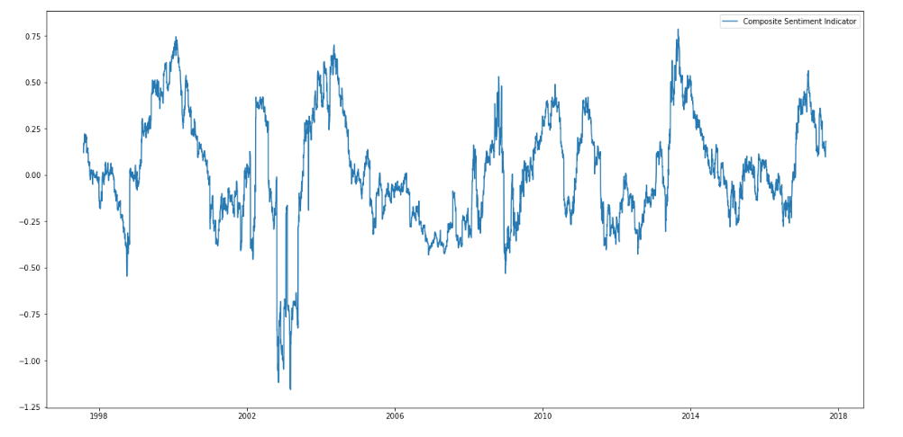
Sentiment Indicator

Slide 20
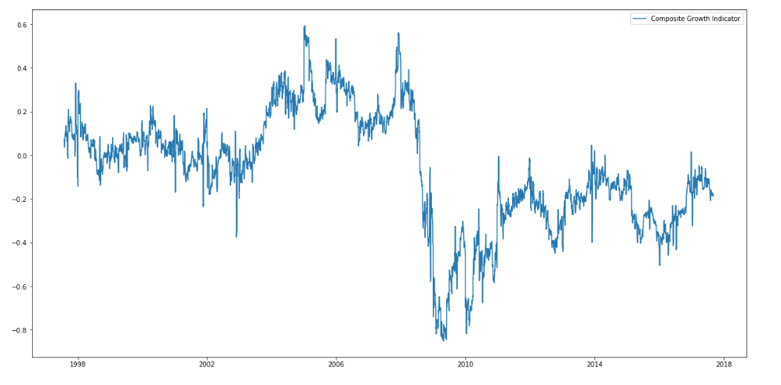
Growth Indicator

Slide 21
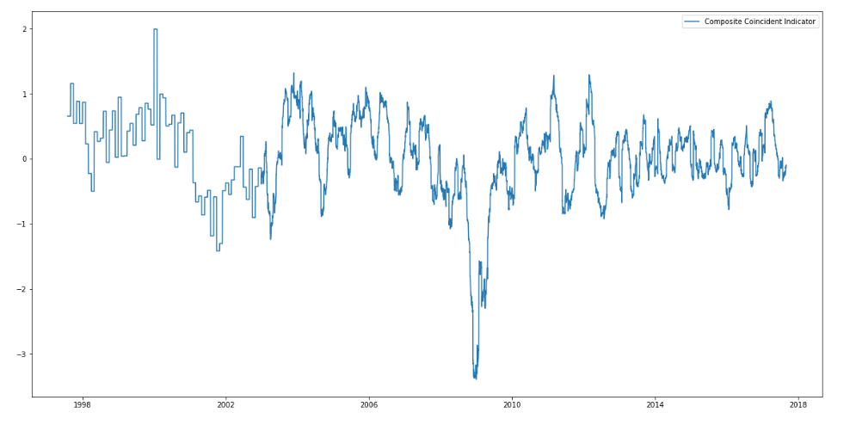
Coincident Indicator

Slide 22
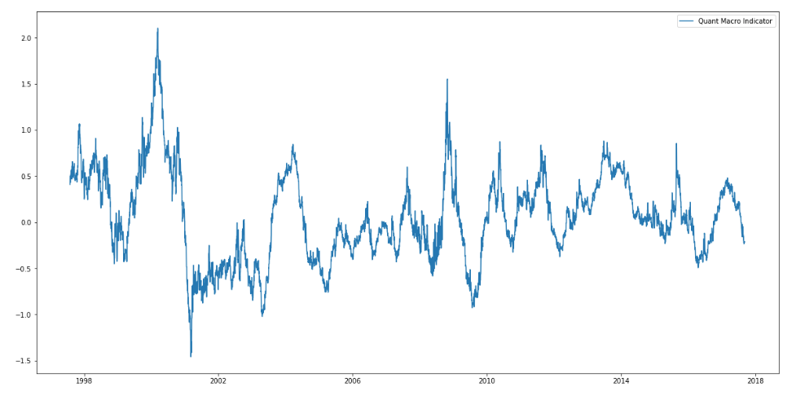
Quant-Macro Indicator

Slide 23
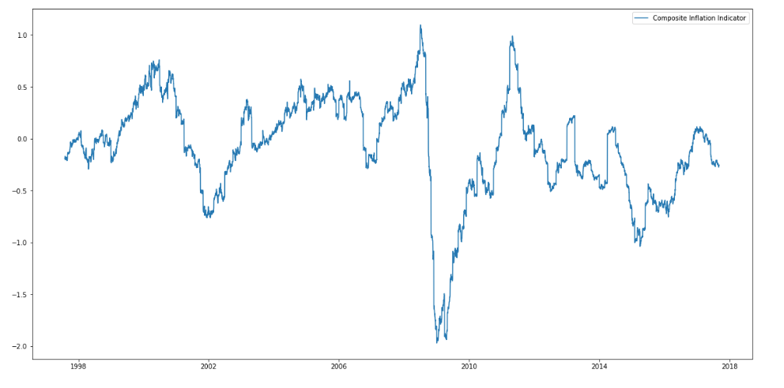
Inflation Indicator

Slide 24
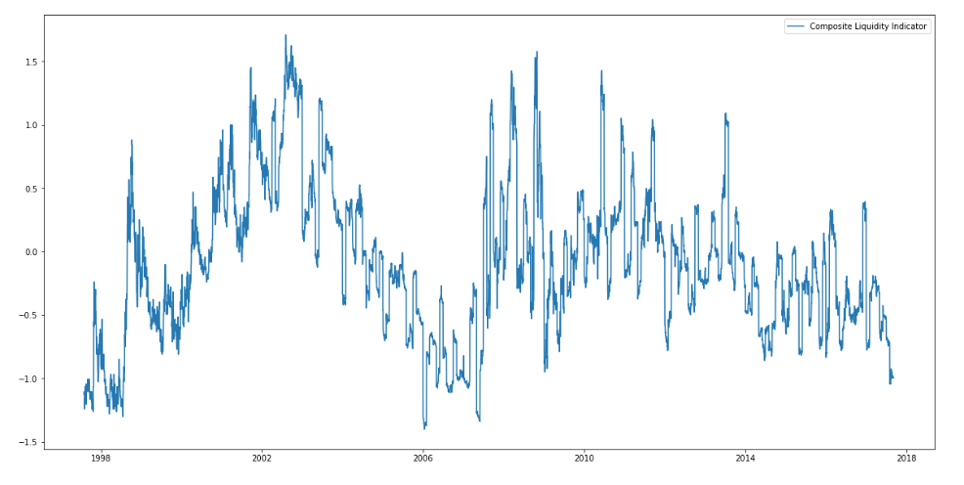
Liquidity Indicator

Slide 25
Clustering

Slide 26
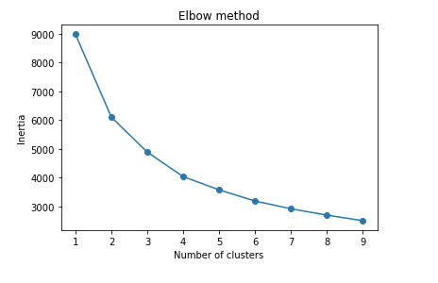
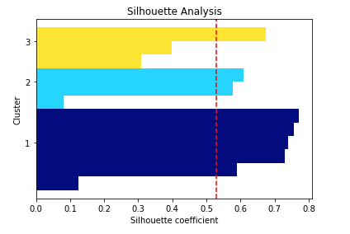
Number of Clusters
I decided to go with 3 clusters

Slide 27
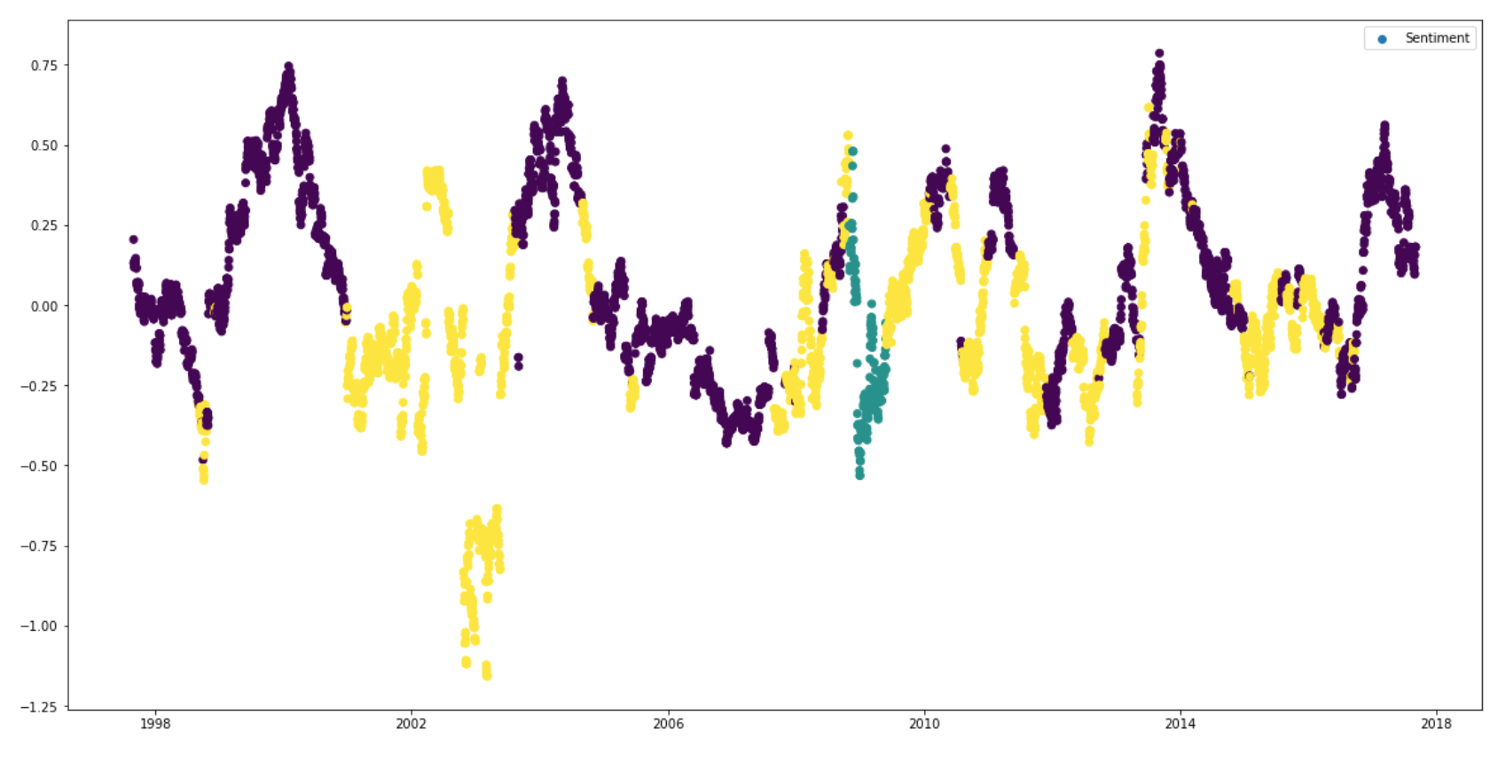
Sentiment Indicator Clustered

Slide 28
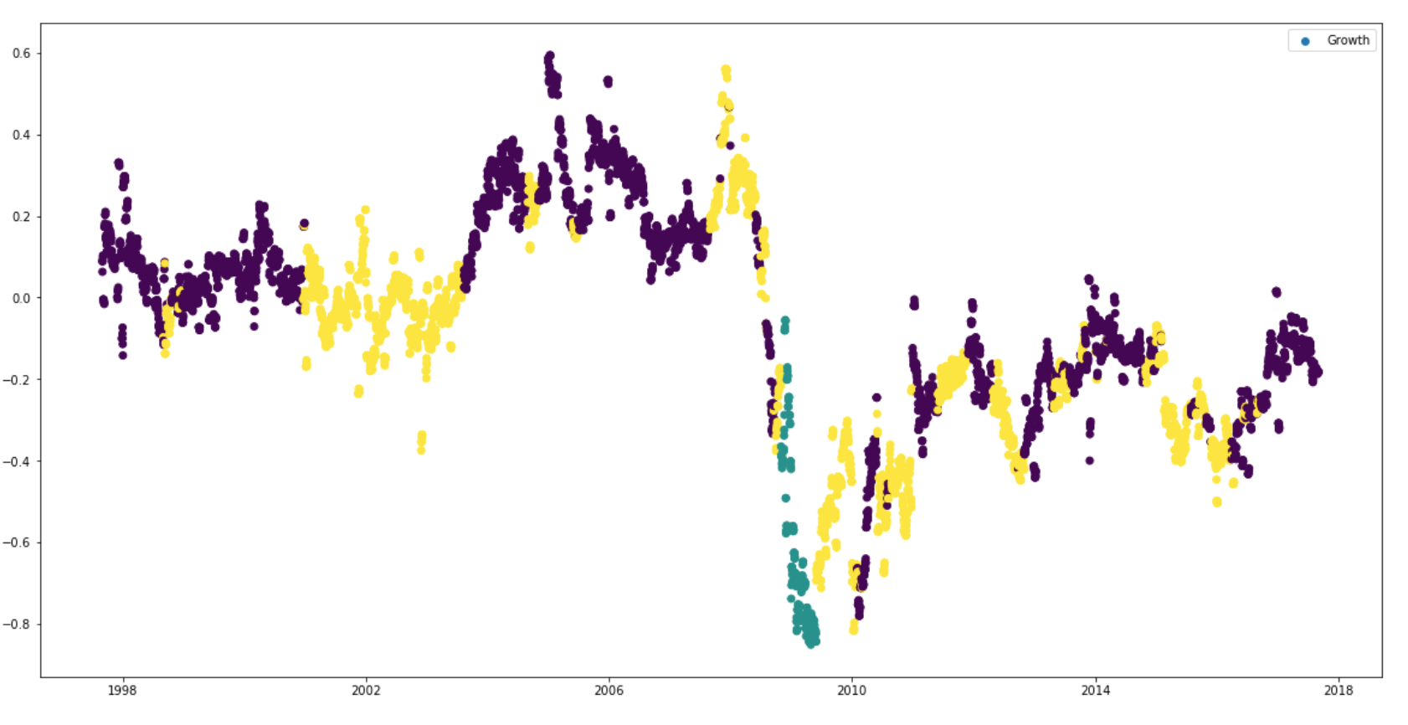
Growth Indicator Clustered

Slide 29
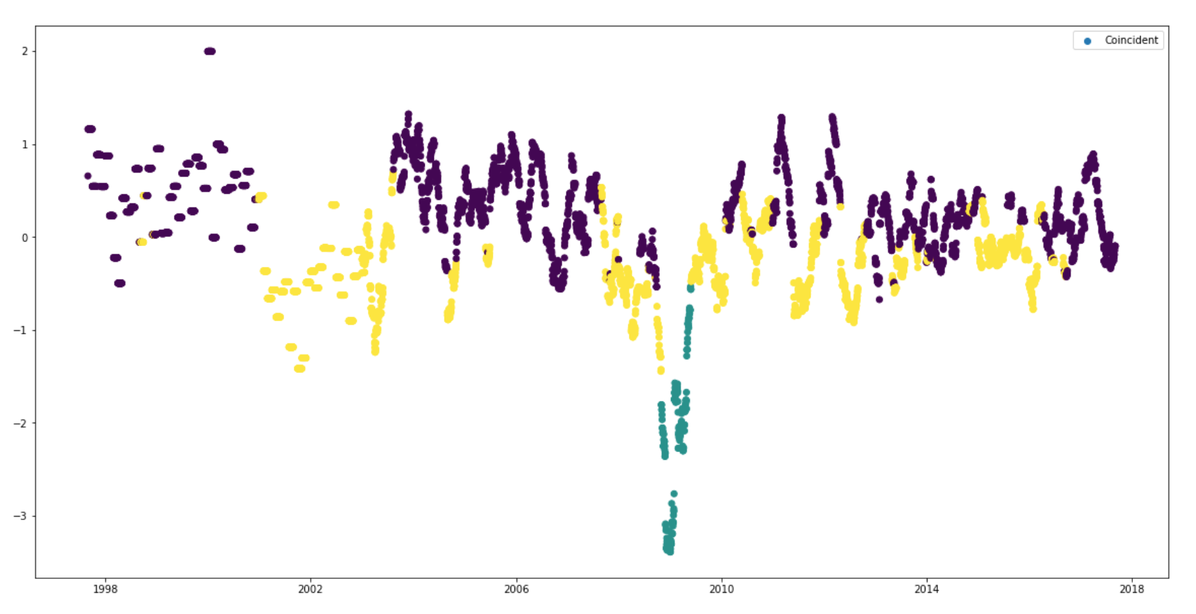
Coincident Indicator Clustered

Slide 30
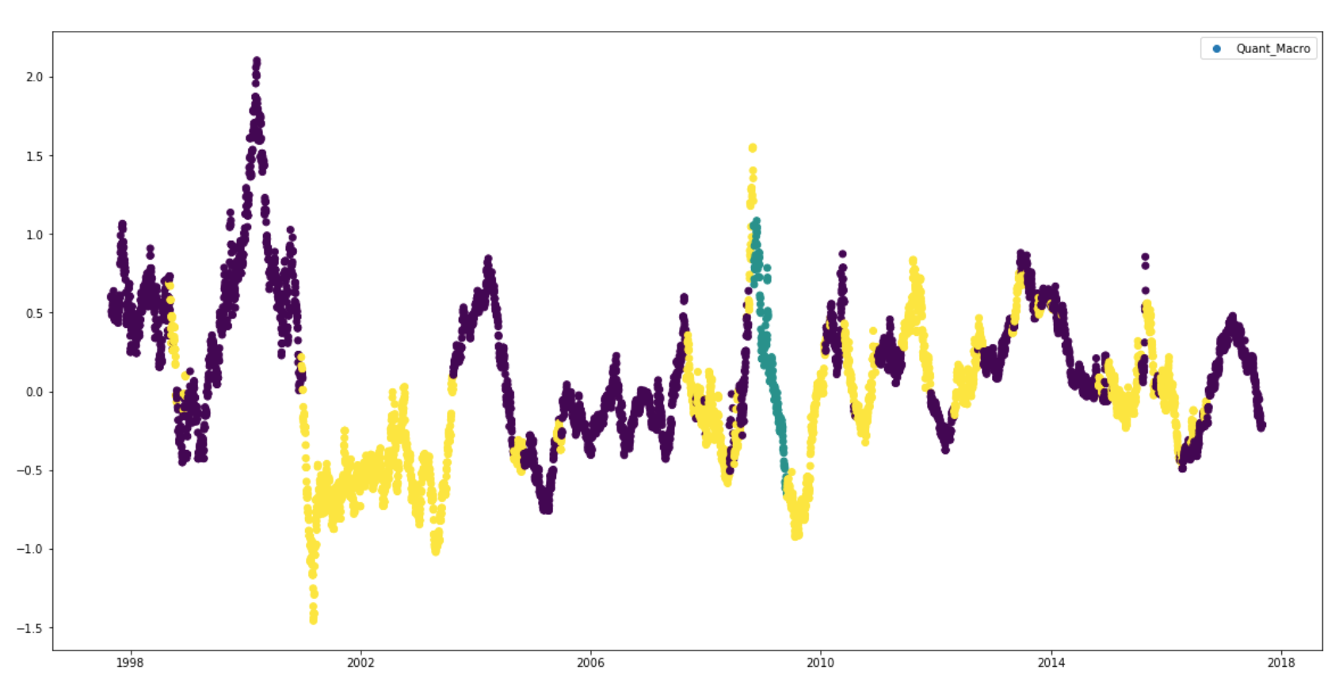
Quant-Macro Indicator Clustered

Slide 31
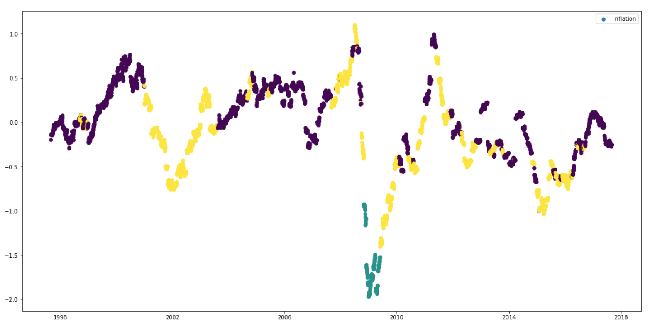
Inflation Indicator Clustered

Slide 32
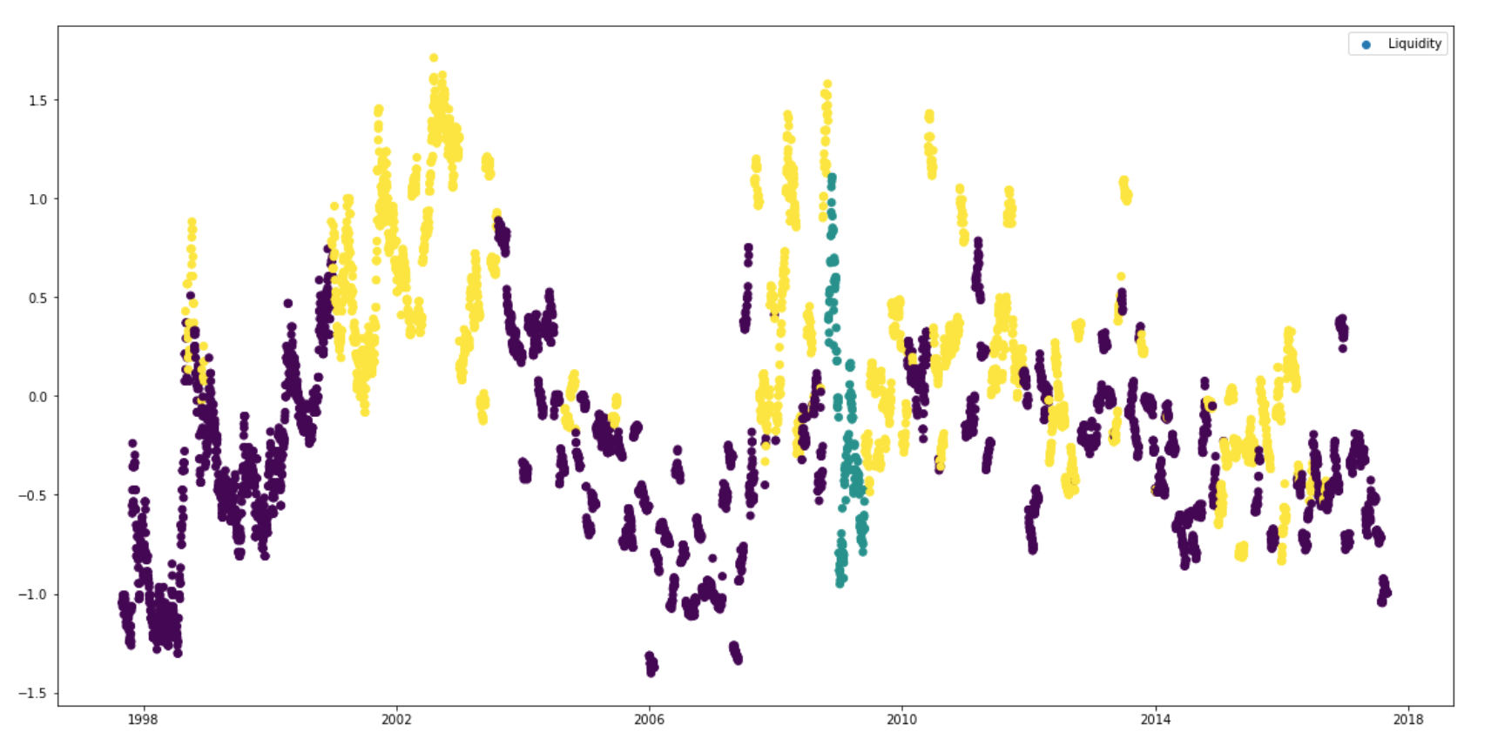
Liquidity Indicator Clustered

Slide 33
Quantopian Strategies

Slide 34
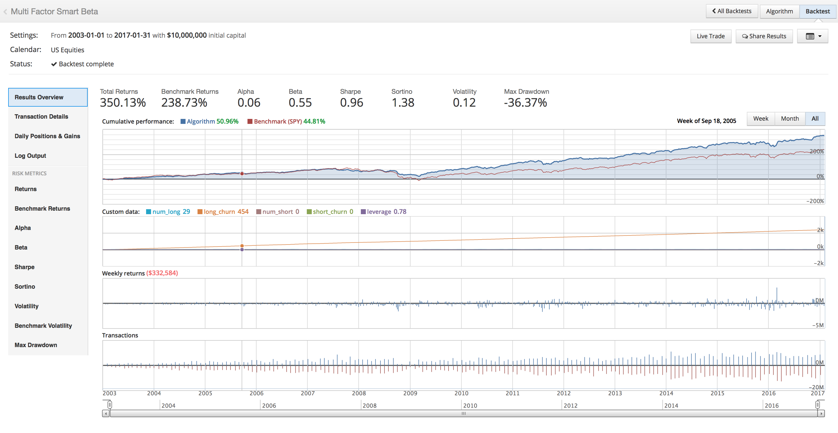
Multi Factor Smart Beta

Slide 35
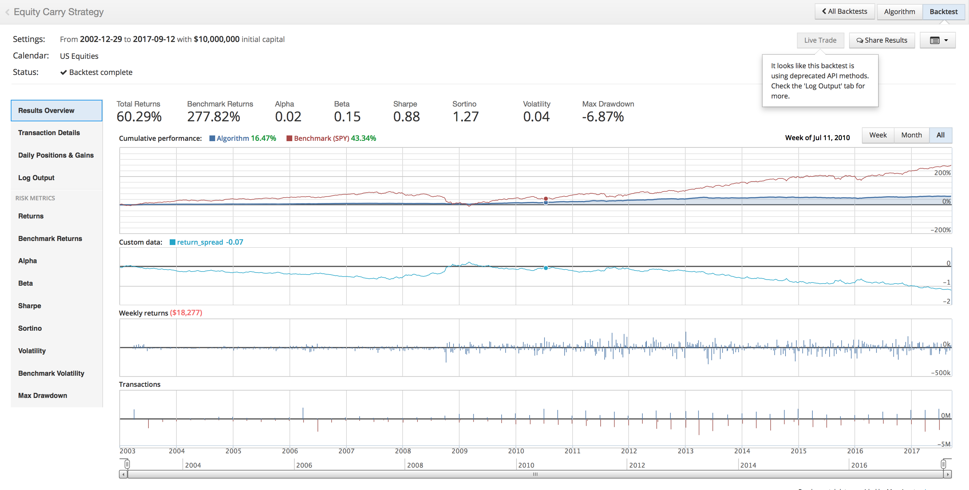
Equity Carry

Slide 36
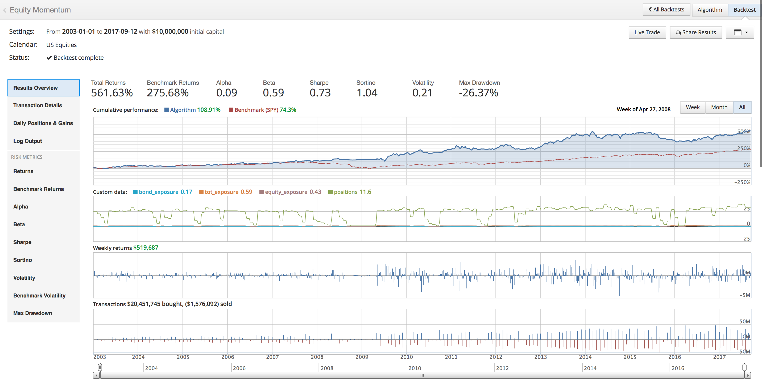
Equity Momentum

Slide 37
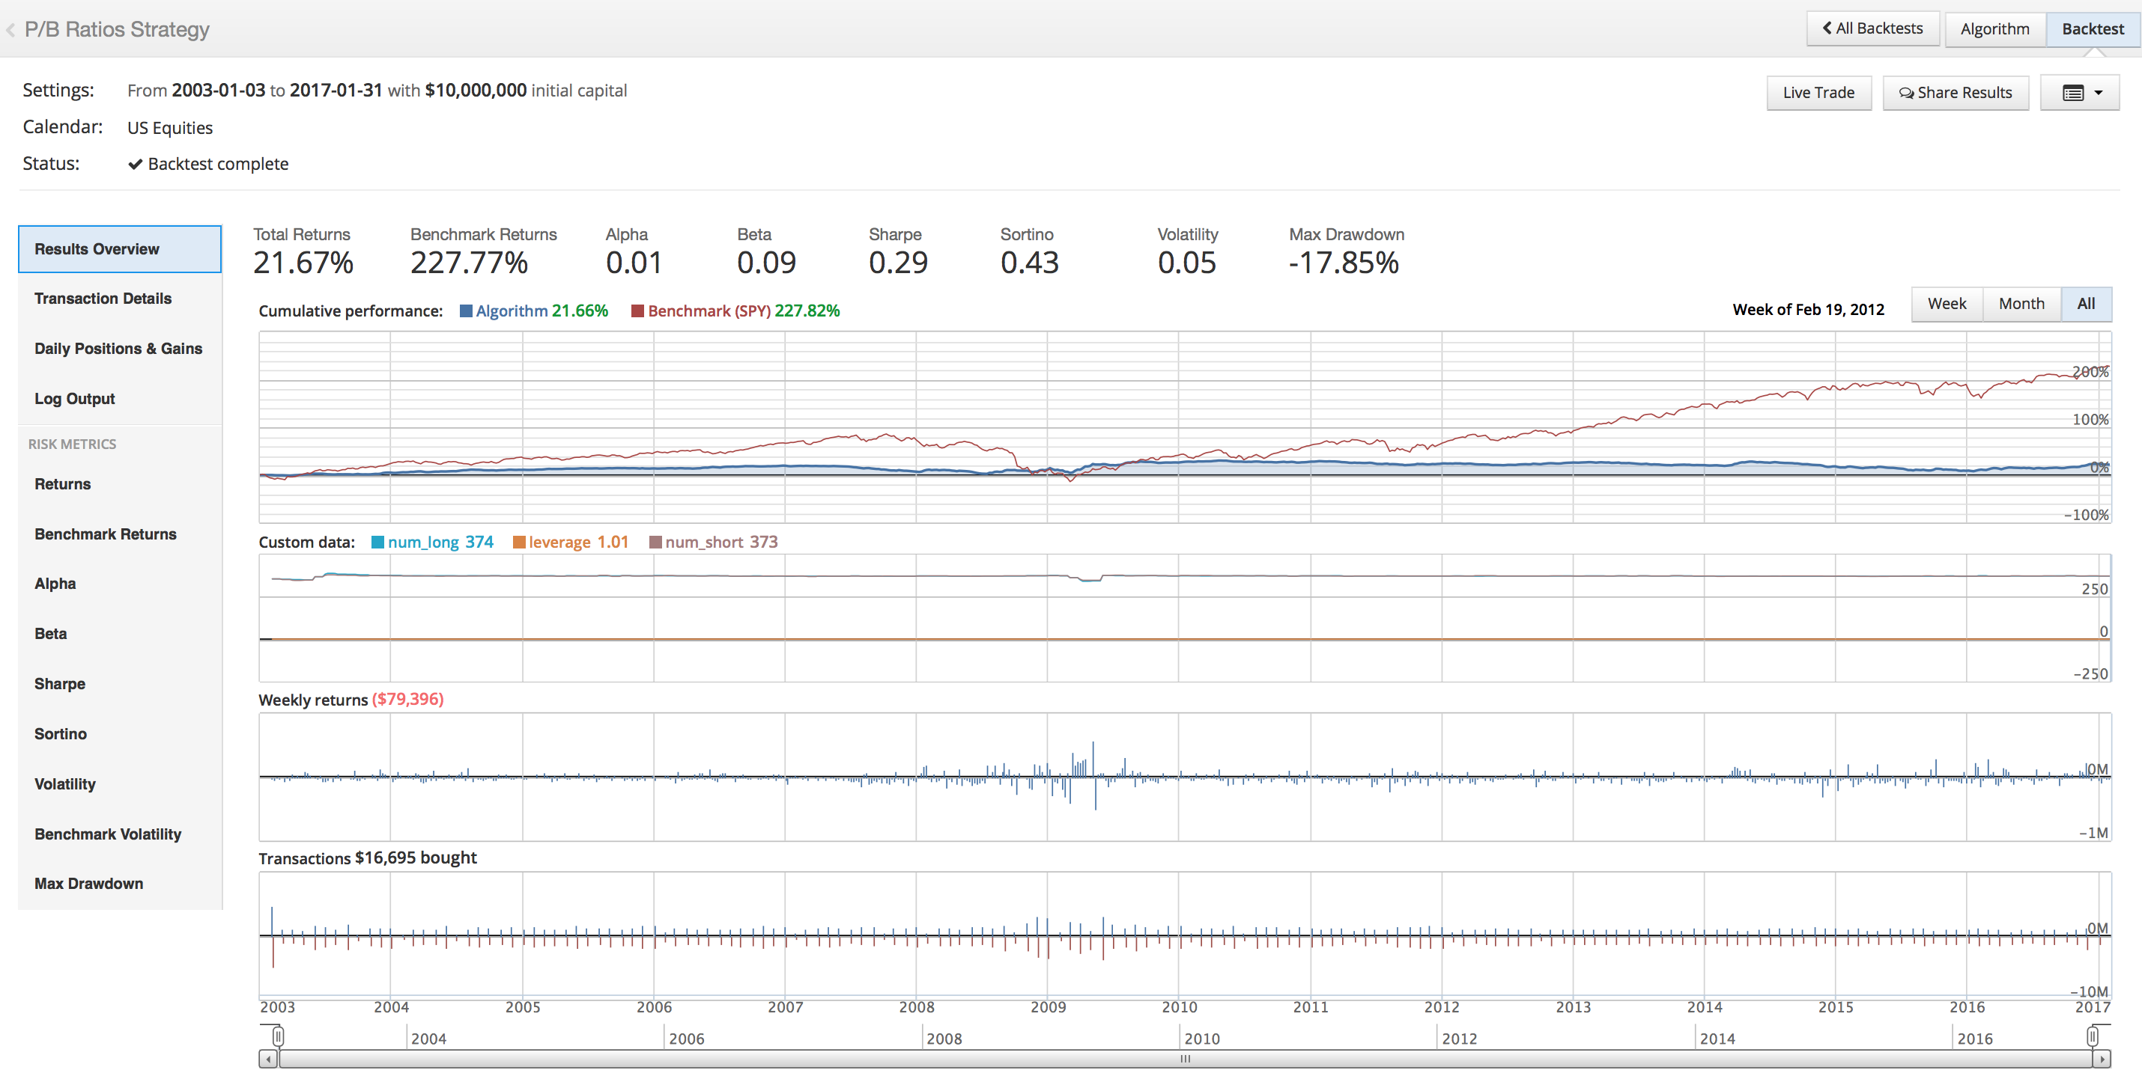
Value Strategy

Slide 38
Next Steps

Slide 39
Backtesting
Get my normalized composite indicators uploaded to Quantopian (I’ve been having trouble with that)
For each month, calculate returns for all 4 strategies
Start a test where the strategy uses K-Nearest Neighbors to find the closest macro points in the past 10 years
Evaluate what strategies worked best during those historical time points
Invest in chosen strategies at the moment and see how returns play out based on this positioning

